Slide 1
Slow Down: Teaching Students to Encode Their Close Reading M. H. Beals @MHBEALS m.h.beals@lboro.ac.uk Loughborough University (with special thanks to Merv Lewis, Chris Corker and Sarah Holland of Sheffield Hallam University)

Slide 2
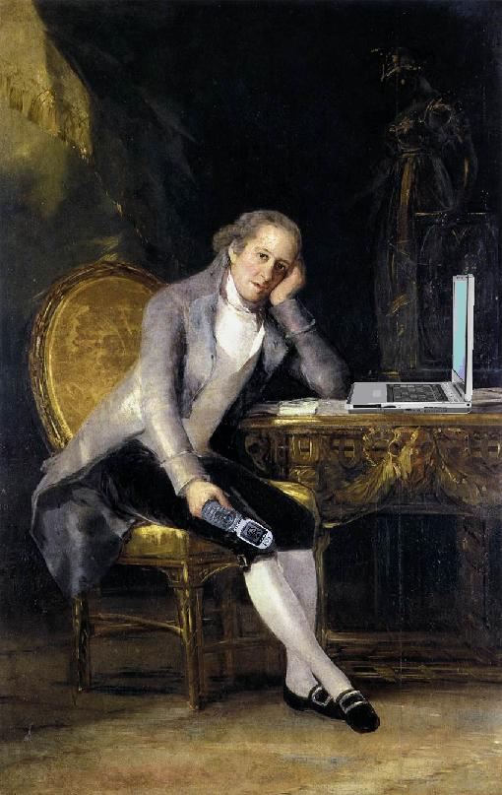
Bridging the Gap
Students Enter
Higher Education History
With a Wide Range of
Explicit and Implicit
Capabilities and Assumptions
…and Mobile Phones
Image Courtesy of Mike Licht (CC BY) at https://www.flickr.com/photos/notionscapital/2313507405

Slide 3
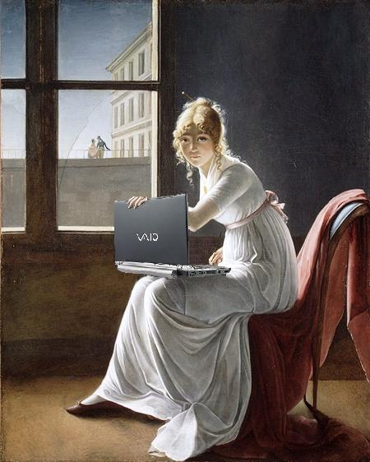
A Perfect Student-Centred Assessment?
First-Year Assessments Should Develop:
Factual Knowledge
Disciplinary Methodologies
Critical Thinking Practices
Communication Skills
Digital Competencies
Autodidactic Tendencies
Disciplinary and Academic Identity
Image Courtesy of Mike Licht (CC BY) at https://www.flickr.com/photos/notionscapital/2738957753

Slide 4
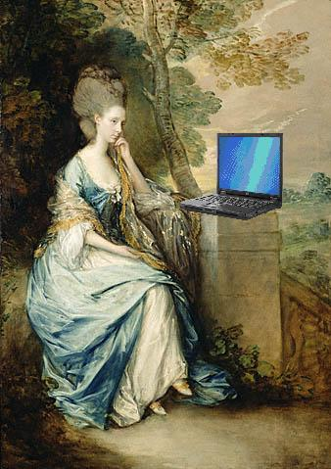
Working Through the Steps
Examining a New Source
Making Identifications
Undertaking Close-Reading
(Please Stay With The Group)
Image Courtesy of Mike Licht (CC BY) at https://www.flickr.com/photos/notionscapital/2560551726

Slide 5

Working Through the Steps
If You Have a Laptop, Please Visit
https://github.com/mhbeals/tei-ihr-workshop

Slide 6
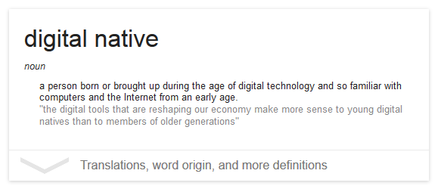
On a Scale of One to Ten...

Slide 7
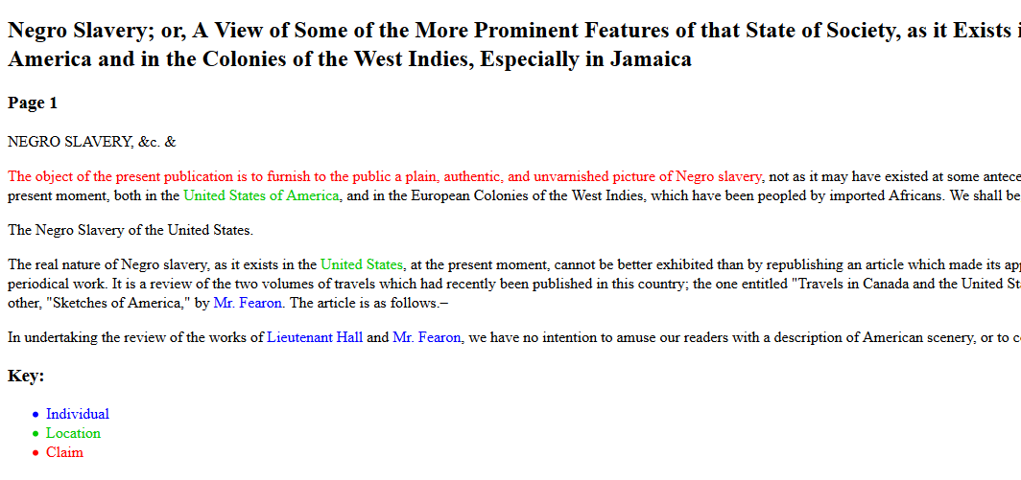
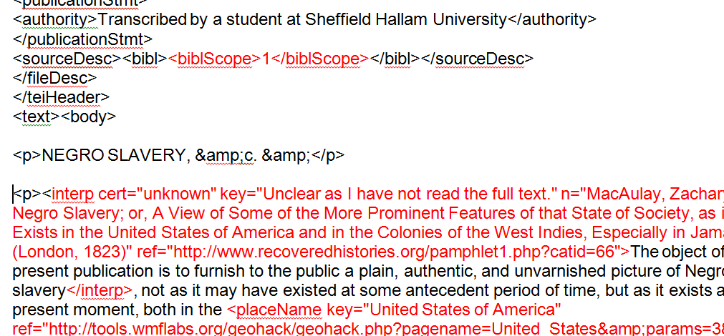
100 Collaborators

Slide 8
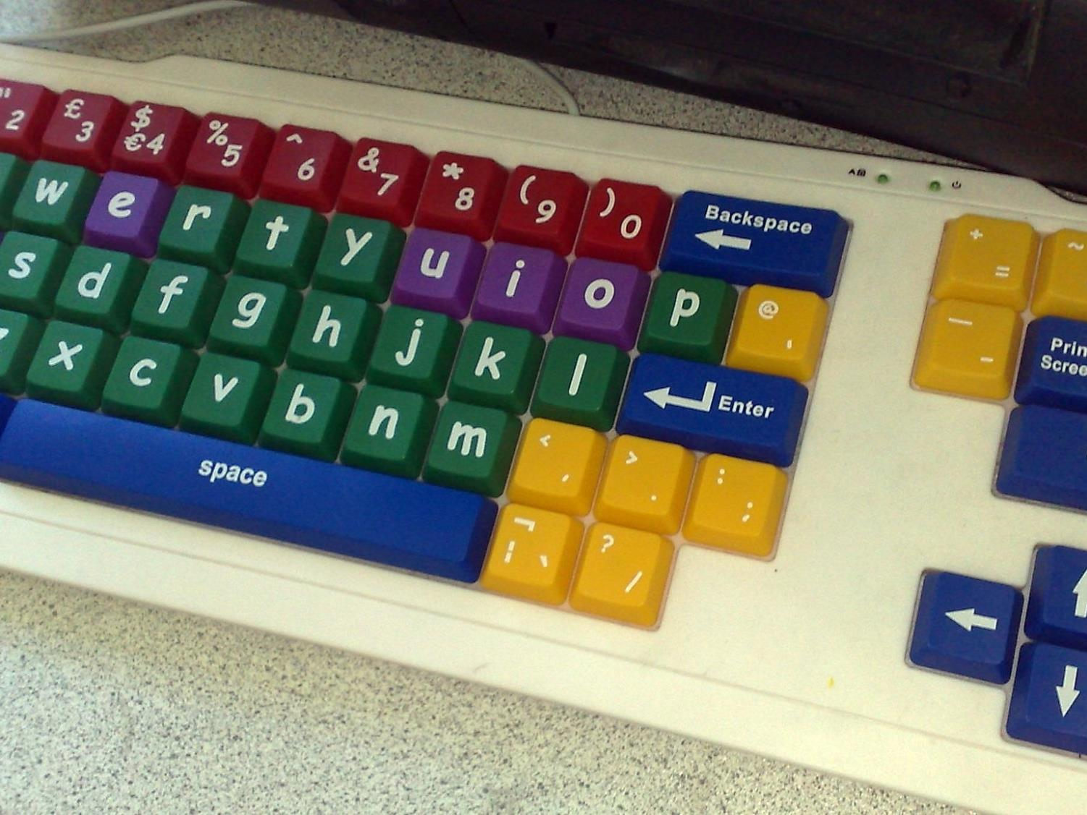

Who Broke Google Drive?
Students Encouraged to Play With Cloud Storage Space Because it is Unbreakable

Slide 9
Looking Forward
Penelope-Style Skills Development
Clear, Consistent Vocabularies
Let them ‘Hate Computers’ but not ‘Give Up’
Do the Preliminaries Every Year

Slide 10
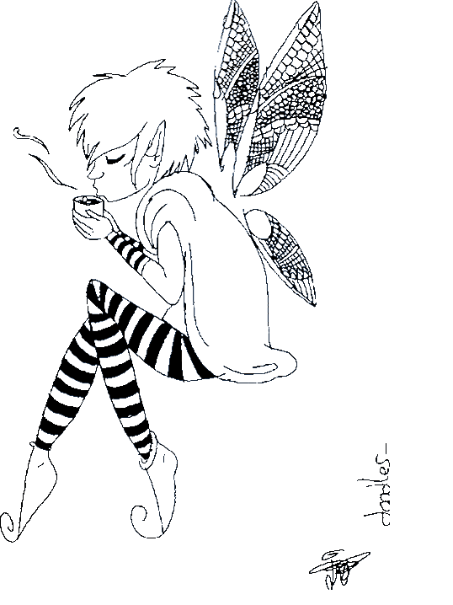
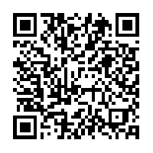
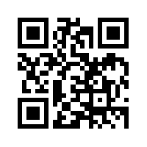
Brought to You By
Good Will
And Faerie Dust
Slides
About Me
All Slides Use CC0 or CC-BY Images and Are Released Under The CC-BY 4.0 Licence

